Slide 1
SCANNING PROBE MICROSCOPY
By
AJHARANI HANSDAH
SR NO.08440

Slide 2
INTRODUCTION
Scanning probe microscopy is an imaging technique in which probe is moved along the surface of specimen.
Provides 3D profile of the specimen surface.
High resolution imaging technique.

Slide 3
DIFFERENT TYPES
Scanning tunneling microscopy
Atomic force microscopy
Tapping mode AFM
Magnetic force microscopy
Electric force microscopy frictional force microscopy
Near field optical microscopy

Slide 4
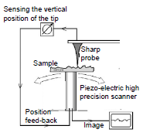
SCHEMATIC DIAGRAM

Slide 5
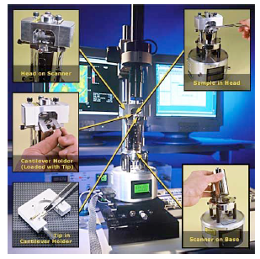
ATOMIC FORCE MICROSCOPY

Slide 6
WORKING PRINCIPLE

Slide 7
CONT…
Probe is supported on flexible cantilever.
Force depends on stiffness of cantilever and distance between probe and sample surface
Motion of probe over the surface is controlled using feedback loop and piezoelectric scanner
Deflection of probe is measured by beam bounce method
Deflections are used to generate surface topography

Slide 8
MODES OF OPERATION
Contact mode - less than 0.5 nm separation distance between probe and surface.
Tapping mode - 0.5 to 2 nm separation distance.
Non-contact mode - 0.1 to 10 nm separation distance.

Slide 9
CONTACT MODE
Short range interactions.
Spring constant of cantilever is less than surface, hence cantilever bends
Force on tip is repulsive.
Force between probe and sample is constant by feedback loop.
For constant height method - no feed back system is used.
Advantages - fast scanning, good for rough samples, used in friction analysis.
Disadvantages - forces can damage soft samples.

Slide 10
TAPPING MODE
May contact surface.
Cantilever is oscillated at resonant frequency.
Amplitude used as feedback.
Maintaining constant oscillation amplitude, by adjusting tip-sample distance.
Advantages - high resolution images for soft samples, good for biological samples.
Disadvantages - difficult to image in liquids, slower scan speeds.

Slide 11
NON-CONTACT MODE
Attractive Vander Walls forces.
Probe oscillates above surface.
Using a feedback loop to monitor changes in amplitude due to attractive forces.
Advantages - very low force exerted on sample, life of probe is more.
Disadvantage - lower resolution, contaminant layer on surface can interfere with oscillation, usually ultra high vacuum is needed.

Slide 12
Plot of force with tip sample distance

Slide 13
ADVANTAGES
3D surface profile.
Sample does not need any treatments or coatings.
Works well in air or liquid environment.
High resolution.

Slide 14
DISADVANTAGES
Image maximum height of 10-20 micrometers and scanning area of 150x150 micrometers.
Low scanning speed.
Image artifact due to high radius of curvature of tip.
Cannot normally measure steep walls or overhangs.

Slide 15
IMAGES

Slide 16
THANK YOU

