Slide 1
WEAR
ME-255
Principles of tribology
GAMIT VIPUL
M.E. (08214)
MECHANICAL ENGG.DEPT.
IISc

Slide 2
Wear
Wear is a process of removal of material from one or both of two solid surfaces in solid state contact, occurring when these two solid surfaces are in sliding or rolling motion together. Bhushan and Gupta (1991)
Wear is the progressive damage, involving material loss, which occurs on the surface
of a component as result of its motion relative to the adjacent working parts.
John Williams

Slide 3
Occurrence of Wear depends on
Geometry of the surface
Applied load
The rolling and sliding velocities
Environmental conditions
Mechanical, Thermal, Chemical and Metallurgical properties
Physical, Thermal and Chemical properties of the lubricant

Slide 4
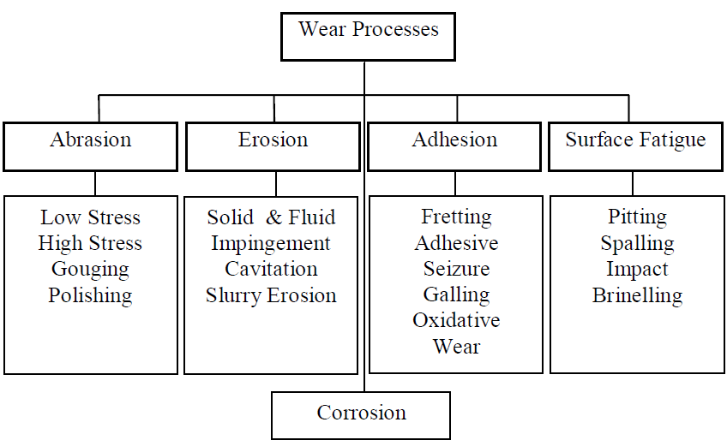
Types of wear process

Slide 5
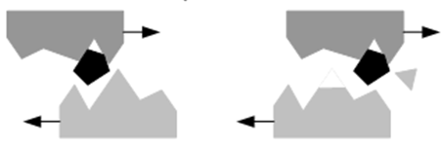
Abrasive wear
Abrasive wear occurs when a harder material is rubbing against a softer material
Two body wear
Three body
wear
V$=K\frac{NL}{3σs}$
Where
V = wear volume, L = sliding velocity
N = applied load, σs = surface strength
K = wear coefficient
Ref.: www.substech.com

Slide 6
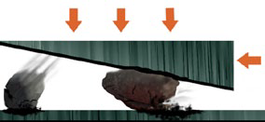
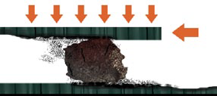
Types of abrasive wear
Gouging abrasion
• Large particles
• High compression loads
High stress or grinding abrasion
• Smaller particles
• High compression load
Low stress or scratching abrasion
• No compression load
• Scratching abrasion while material is sliding
Polishing abrasion
Ref.: www. mesto.com

Slide 7
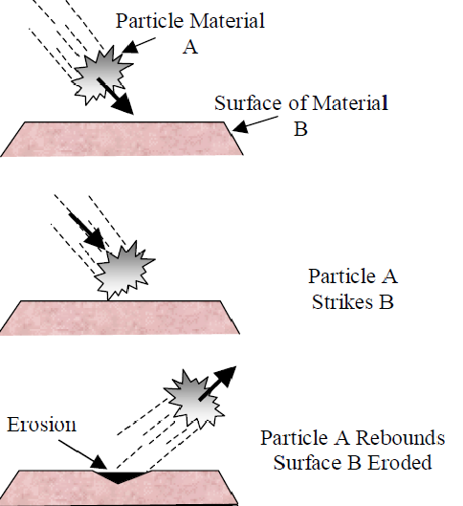
Erosive wear
The impingement of solid particles, or small drops of liquid or gas on the solid surface cause wear what is known as erosion of materials and components.
Pressure generated due to change in velocity
P = 𝞓V$\sqrt{Eρ}$
P = Impact pressure
E = Modulus of elasticity of impacted material
𝞺 = Density of the fluid
V = Velocity
Advantages
Cutting, drilling and polishing of brittle material
Ref.: dcu.ie/~stokesjt/Thermal Spraying/Book/Chapter1

Slide 8
Types of erosion
Solid particle erosion
Surface wear by impingement of solid particles carried by a gas or fluid.
e.g. Wear of helicopter blade leading edges in dusty environments.
• Liquid drop erosion
Surface wear by impingement of liquid drops.
e.g. Wear of centrifugal gas compressor blades by condensate droplets.
• Cavitation erosion
Surface wear in a flowing liquid by the generation and implosive collapse of
gas bubbles.
e.g. Fluid-handling machines as marine propellers, dam slipways, gates, and
all other hydraulic turbines.
Cavitation wear occurs when a solid and a fluid are in relative motion. i.e. Cavitation wear occurs from the collapse of cavitation bubbles.

Slide 9
Frictional wear / adhesive wear
Two bodies sliding over or pressed into each other which promote the material
transfer from one to another.
$$\frac{V}{L}=K\frac{P}{3σy}$$
Where
V = wear volume
L = sliding velocity
P = applied load
σy = yield stress of softer material
K = wear coefficient
Ref.: www.substech.com

Slide 10
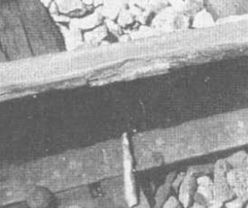
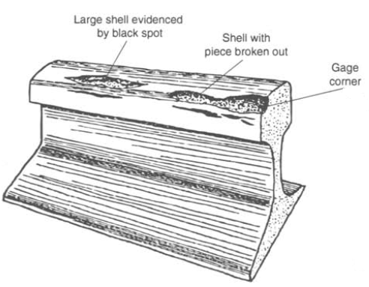
Surface fatigue
Two surfaces contacting to each other under
pure rolling, or rolling with a small amount of
sliding in contact
Contact fatigue
As one element rolls many times
over the other element
Maximum shear stress is higher
than fatigue limit
For cylinder
$τmax$=$0.127\sqrt{\frac{PEe}{LRe}}$
Z= 0.84$\sqrt{\frac{PRe}{LEe}}$
For sphere
τmax = 0.4$\sqrt[3]{\frac{P}{R^{2}}{Ee}^{2}}$
Z = 0.56$\sqrt[3]{P\frac{Re}{Ee}}$
Ref.:W.A. Glaeser and S.J. Shaffer, Battelle Laboratories

Slide 11
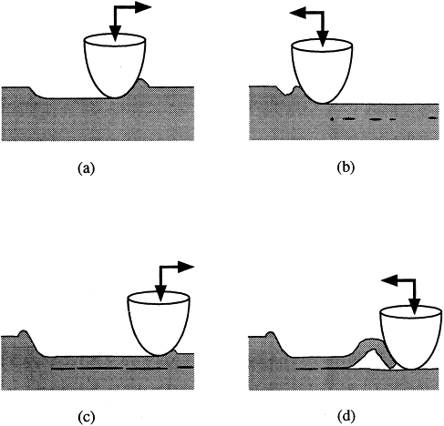
Delamination wear
A wear process where a material loss from the surface by forces of another surface acting on it in a sliding motion in the form of thin sheets.
Mechanisms of delamination wear
Plastic deformation of the surface
Cracks are nucleated below
the surface
Crack propagation from these
nucleated cracks and joining with
neighbouring one
After separation from the surface,
laminates form wear debris
Ref.: K Kato, M Bai, N Umehara, Y Miyake

Slide 12
Chemical wear
Environmental conditions produce a reaction product on one or both of rubbing
surface and this chemical product is subsequently removed by the rubbing action.
Methods for control of the wear
Lubrication technology
Materials substitution
Load reduction
Removal of impact conditions

Slide 13
References
Effect of internal stress of CN_{x} coating on its wear in sliding friction - K Kato, M Bai, N Umehara, Y Miyake
TRIBOLOGY: THE SCIENCE OF COMBATTING WEAR - William A Glaeser (Member, STLE), Richard C Erickson (Member, STLE), Keith F Dufrane (Member, STLE) and
Jerrold W Kannel Battelle Columbus, Ohio
Classification of wear mechanisms/models - K Kato
www.rermwiki.com
W.A. Glaeser and S.J. Shaffer, Battelle Laboratories
www.substec.com
Friction and lubrication in mechanical design – A. A. Seireg
ocw.mit.edu/courses/mechanical-engineering/2-800-tribology
dcu.ie/~stokesjt/Thermal Spraying/Book/Chapter1
Wikipedia

Slide 14
