Slide 1
ADSORPTION
by
Pranoy Pratik Raul

Slide 2
Content
Definition
Cause
Classification
Isotherms
Applications
Only 12 slides

Slide 3
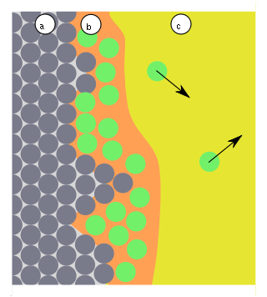
What is Adsorption?
Adsorption is a process that occurs when a gas or liquid solute accumulates on the surface of a solid or a liquid (adsorbent), forming a molecular or atomic film (adsorbate)
ADSORBENT
ADSORBATE
SOLUTION

Slide 4
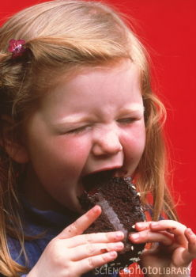
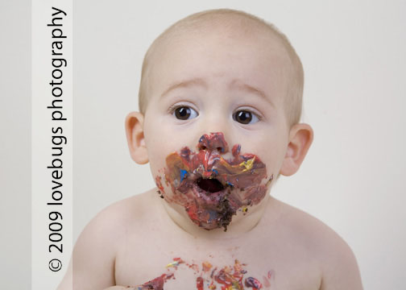
Absorption vs. Adsorption
Bulk (Volume)
Phenomenon
Surface Phenomenon

Slide 5
Why does Adsorption occur ?
Consequence of surface energy
Atoms on the surface experience a bond deficiency, because they are not wholly surrounded by other atoms

Slide 6
Types of Adsorption
PROPERTIES | PHYSISORPTION | CHEMISORPTION
Bonding | WEAK, LONG RANGE Van der Waals interactions (e.g. London dispersion, dipole-dipole).. | STRONG, SHORT RANGE Chemical bonding involving orbital overlap and charge transfer.
Enthalpy | 5-50 kJ mol⁻¹ | 40-800 kJ mol⁻¹
Saturation | Multi-layer | Mono-layer
Surface Specificity | No | Yes
Nature | Reversible | Mostly Irreversible

Slide 7
Adsorption Isotherms
Plot of the amount of adsorbate on the adsorbent as a function of its pressure (if gas) or concentration (if liquid) at constant temperature.
Langmuir isotherm (adsorbed layer one molecule thick)
Freundlich isotherm (Heterogeneous adsorbent surface with different adsorption sites)
Brunauer, Emmett and Teller (BET) isotherm (molecules can be adsorbed more than one layer thick)

Slide 8
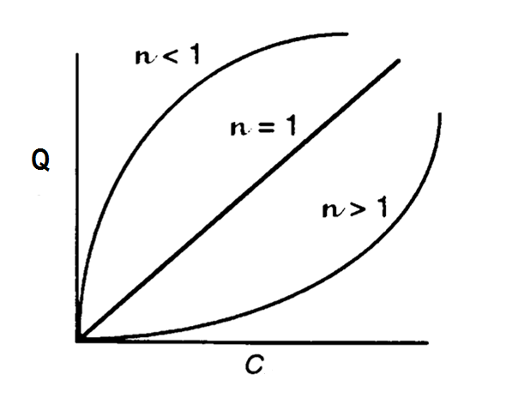
Freundlich Isotherm
Freundlich and Küster (1909)
Empirical formula:
Limitation: Fails at high pressures
Q- Mass of adsorbate / mass of adsorbent
p- equilibrium pressure of adsorbate
c- equilibrium con. Of adsorbate in solution
K,n- constants

Slide 9
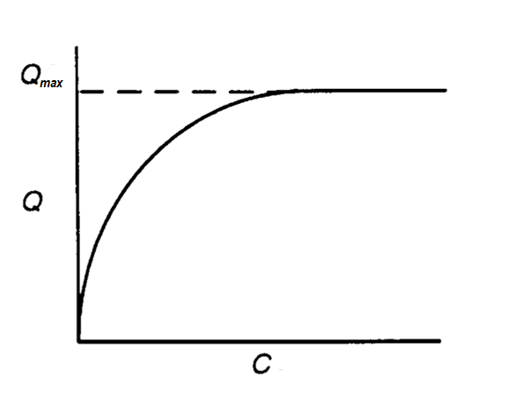
Langmuir Isotherm
Irving Langmuir (1916)
Assumptions:
Uniformity of sites Non interaction
Common Mechanism Monolayer only
Semi-Empirical Formula:
Q- Mass of adsorbate / mass of adsorbent
Qmax- Maximum Q to form a mono-layer
c- equilibrium con. of adsorbate in solution
K - constant

Slide 10
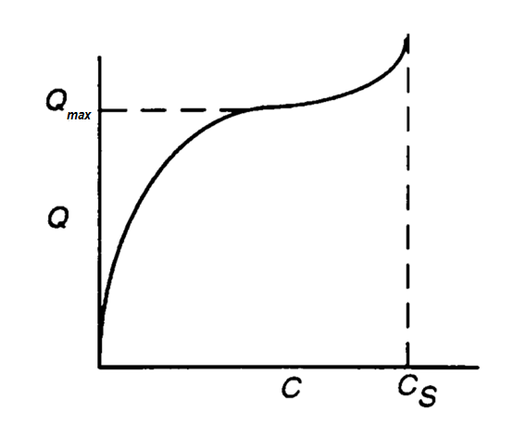
BET Isotherm
Stephen Brunauer, Paul Hugh Emmett and Edward Teller (1938)
Assumptions:
Multilayer No Transmigration
Equal Energy Langmuir to each layer
C_{S} - saturation (solubility limit) concentration of the solute(mg/liter)
K_{B} - a parameter related to the binding intensity for all layers.

Slide 11
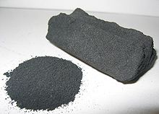
Applications
Activated Carbon
Hydrophobic Surface area-500m²/g
Waste water treatment
Decontaminant in pharmacy
Silica Gel and Zeolites
Hydrophilic Polar
Drying of process air
CO₂ and Hydrocarbon removal from natural gas
Vapor Adsorption Refrigeration
Protein Adsorption on biomaterials(cells)

