Slide 1
ME 225 ; PRINCIPLES OF TRIBOLOGY
PRESENTATION ON
FRICTION – LAWS – GENESIS - MECHANISMS
SIDDAPPAJI .B

Slide 2
FRICTION
A force that resists the relative motion or tendency to such motion of two bodies in contact.
Friction always works in the direction opposite from the direction the object is moving, or trying to move.
Friction always slows a moving object down.
Friction also produces heat.
Keep frictional forces as small as possible.

Slide 3
PLACES WHERE FRICTION IS GOOD
Prevents our shoes slipping on the pavement when we walk
Stops car tyres skidding on the road
A nail hammered into a piece of wood
Grip between nut and bolt
The feet of table legs
Rock climbing holds
Brakes
Ice causes very little friction, hence it is easy to slip over on an icy day. good thing for ice skating and sledging.

Slide 4
PLACES WHERE FRICTION IS BAD
Sometimes we want to reduce friction
In engines
In transmissions
On the bottoms of skis and snowboards (To a point)
When you are trying to move a box by pushing it along the floor

Slide 5
CLASSICAL LAWS OF FRICTION
v
F_{f} = μ F_{N} F_{N=} Normal Force
2) μ independent of apparent contact area
3) μ independent of sliding speed
m
F_{f}
^{1, 2} Guillaume Amontons, 1699
³ Charles-Augustin de Coulomb, 1785
mg
F_{N}
μ depends on whether object is at rest or moving - “static friction” vs. “kinetic friction”.
μ_{s} ≥ μ_{k}
Third Amontons Law
Meanwhile, for solid-liquid interfaces, “viscous friction” applies, where,

Slide 6
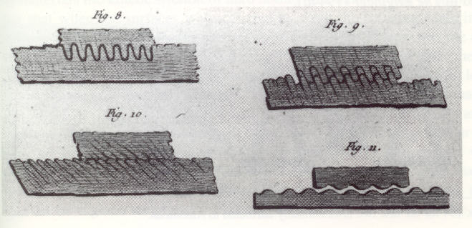
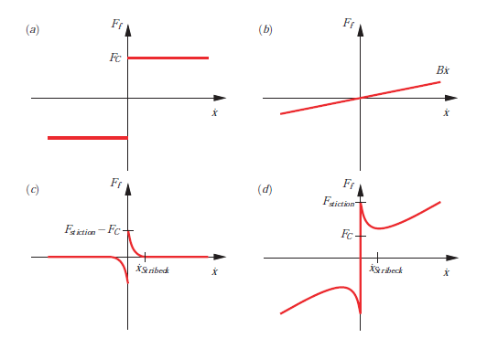
Coulomb Friction depended on the asperities of the two surfaces becoming inerlocked
Charles-Augustin de Coulomb
Théorie des Machines Simple
1785

Slide 7
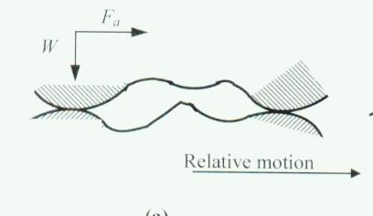
BASIC MECHANISMS OF DRY FRICTION
Adhesion
Deformation
The adhesive force is linked to the asperity-asperity contact
W = A × H
W=Load
A= True area of contact
H= Hardness
κ = Shear Strength
F=Total Frictional Force
P_{m} = Mean Pressure
P= Normal pressure
α= constants
F= A × κ
Junction growth phenomenon
P_{m} =
=α2

Slide 8
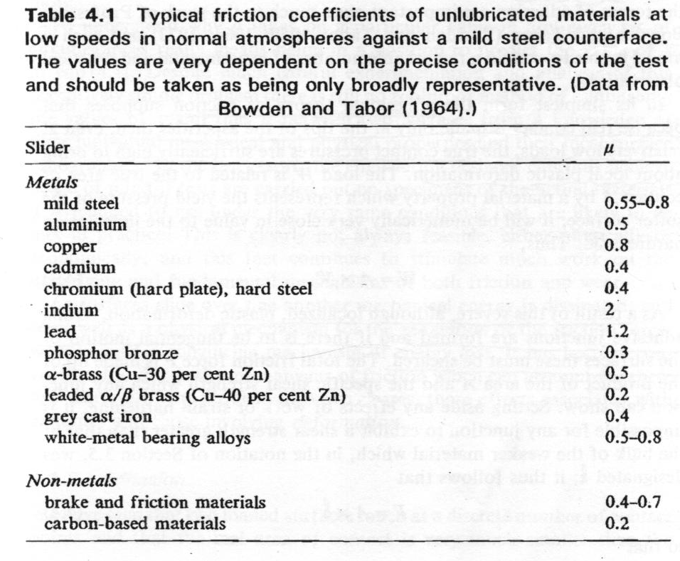

Slide 9
Deformation
The deformation component of friction
Two opposing asperities in oblique contact near their summits at a small angle, Ө
F = F_{a} + F_{d}
F_{a}= tangential force
F_{d}= deformation force

Slide 10
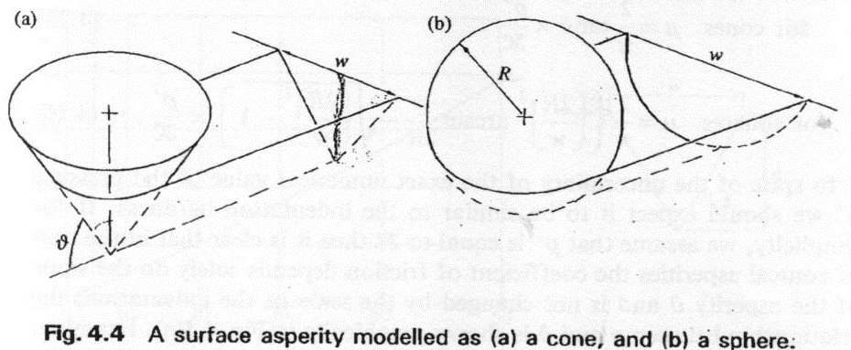
Deformation continued
Width of groove
Slope of the asperity
pressure
c/s area of groove

Slide 11
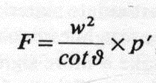
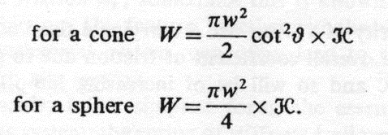
Deformation continued
For a cone asperity
For a cone
For a spherical asperity
Normal Load and penetration Hardness related

Slide 12
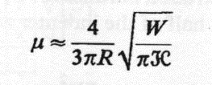
Deformation continued

Slide 13
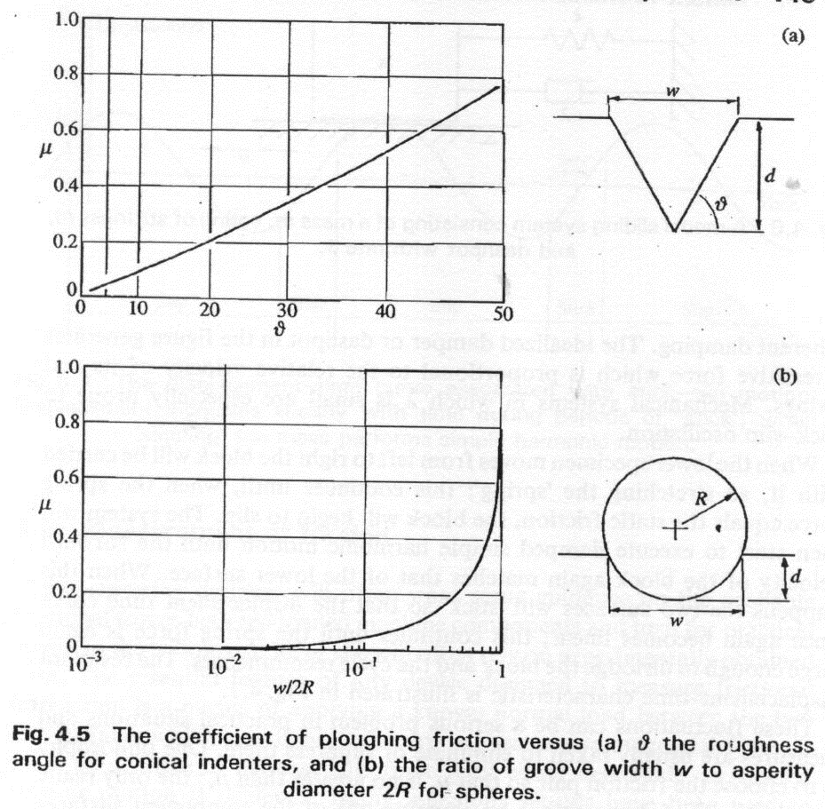
Deformation continued

Slide 14
FREE BODY DIAGRAM
Normal Force F_{N}
Applied Force F
Friction Force f_{f}
Gravity Force F_{g}
F_{g} = mg
F_{N} = F_{g}
f_{f} = F

Slide 15
STATIC FRICTION
The Force of Static Friction keeps a stationary object at rest!
F_{N}
F
f_{s}
F_{g}

Slide 16
KINETIC FRICTION
Once the Force of Static Friction is overcome, the Force of Kinetic Friction is what slows down a moving object!
Motion
F_{N}
F
f_{k}
F_{g}

Slide 17
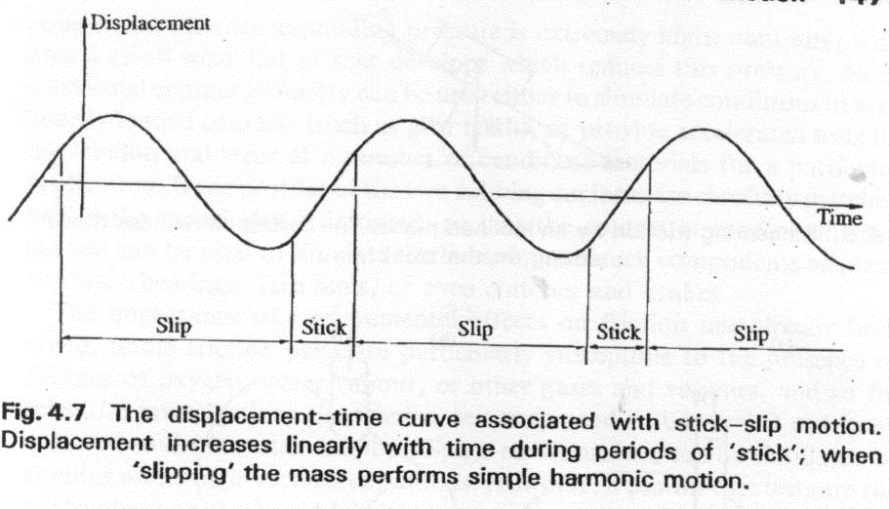
STICK-SLIP EFFECTS

Slide 18
STATIC & KINETIC FRICTION COEFFICIENTS
Material | Coefficient of Static Friction μ_{S} | Coefficient of Kinetic Friction μ_{k}
Rubber on Glass | 2.0+ | 2.0
Rubber on Concrete | 1.0 | 0.8
Steel on Steel | 0.74 | 0.57
Wood on Wood | 0.25 – 0.5 | 0.2
Metal on Metal | 0.15 | 0.06
Ice on Ice | 0.1 | 0.03
Synovial Joints in Humans | 0.01 | 0.003

Slide 19
THANK YOU VERY MUCH

Slide 22
v
m
v
F_{f}
m
F
mg
F_{N}
F = ma
F_{f} = μ F_{N}
Newton, 1686
Amontons, 1699

